Slide 1

Intro to Practical development
Making things with raspberry Pi and Python!

Slide 2



before we begin
Logistics and important info
Introductions
Name
What do you want to learn today?
Last time you apologized?
Notes:
LOGISTICS
INTRODUCTIONS

Slide 3
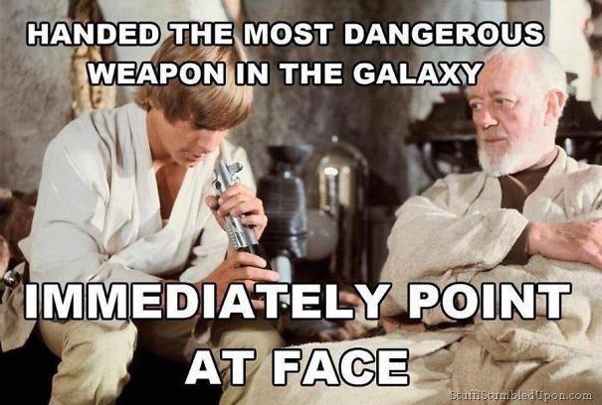
What will you get out of today’s session?
Just enough to be dangerous CURIOUS and do more!
Notes:
THIS IS DESIGNED TO GIVE YOU THE BASICS SO YOU CAN GO FURTHER ON YOUR OWN

Slide 4
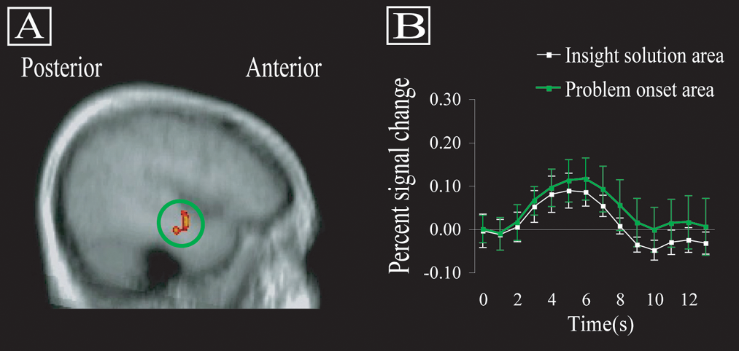
Practical Development
Why “practical” development?
Physical confirmation of logical creations
The “aha” moment
Notes:
WHY PRACTICAL DEVELOPMENT?
WHY THIS PROJECT?
WHERE DID THIS IDEA COME FROM?
Make sure to tell the story about your son being loud and wanting a way to influence his behavior

Slide 5
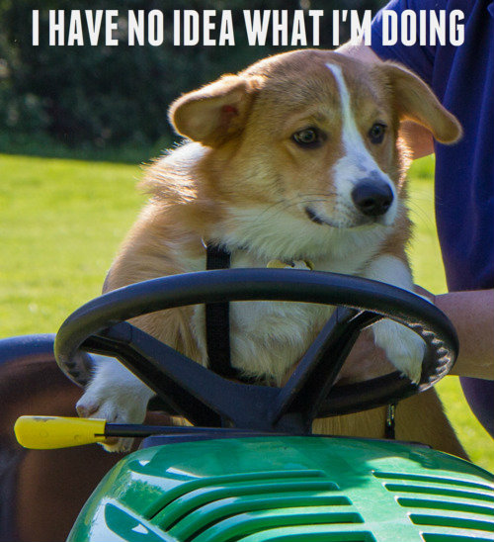

What *are* we doing?
Electrical Engineering 50
Basic Python 100
How to be a tinkerer
Making! Hacking! Developing!
Notes:
In the next 3 hours I will give you:
A crash course in EE
A basic developer course in Python
How to be a tinkerer

Slide 6
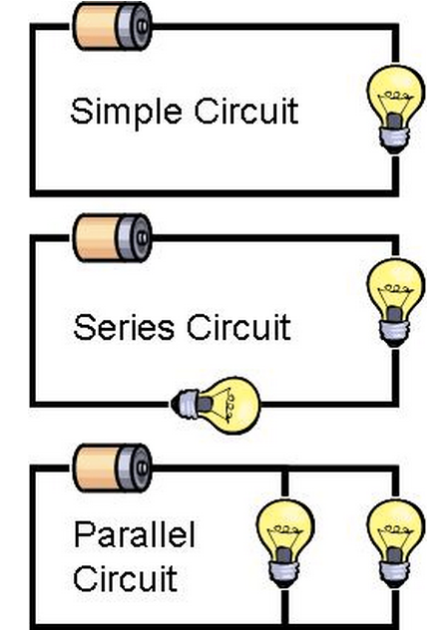
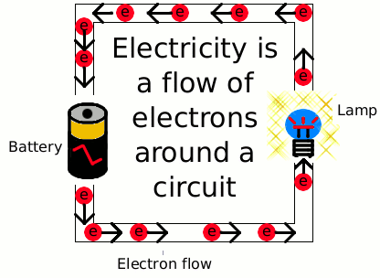
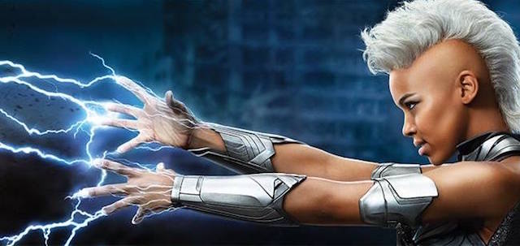
Hardware fundamentals
Building hardware is all about controlling electricity
Flow is controlled through a circuit
You have now mastered electricity and are basically an X-Men*
*Inclusion in X-Men adventures not guaranteed
Notes:
Wiring is a lot like plumbing
Power out or - terminal is the “faucet”
Ground or the + terminal is the “drain”

Slide 7
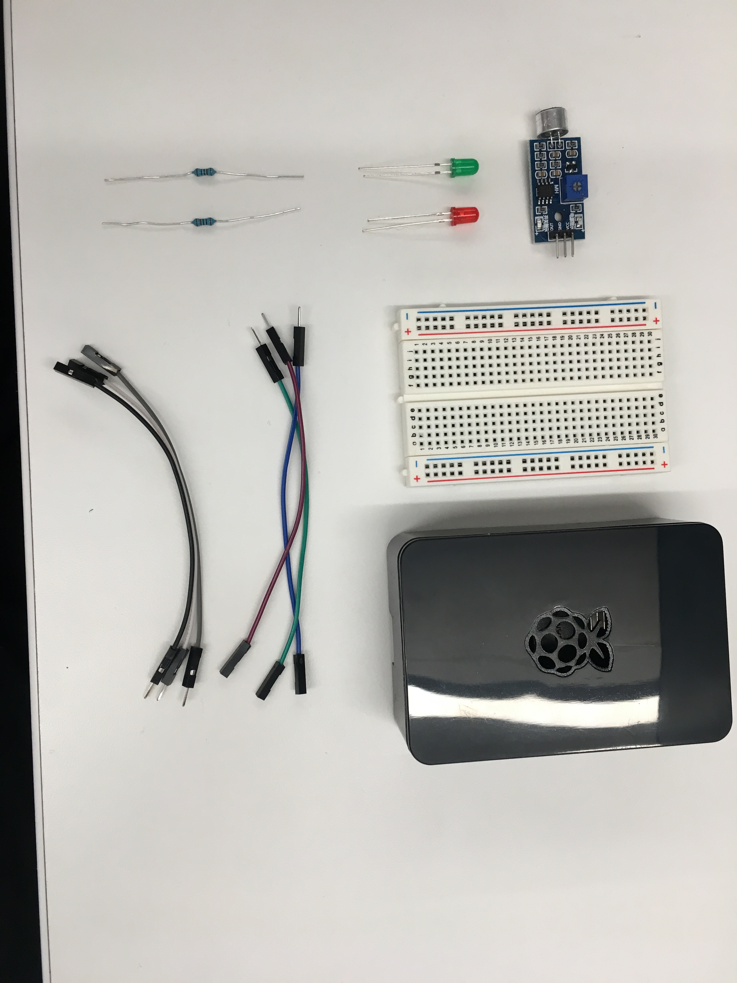
OUR Hardware – AKA What’s in this box?
Basic hardware required to build our project
Breadboard
Wires
Lights
Resistors
Sensor
Raspberry Pi 3

Slide 8
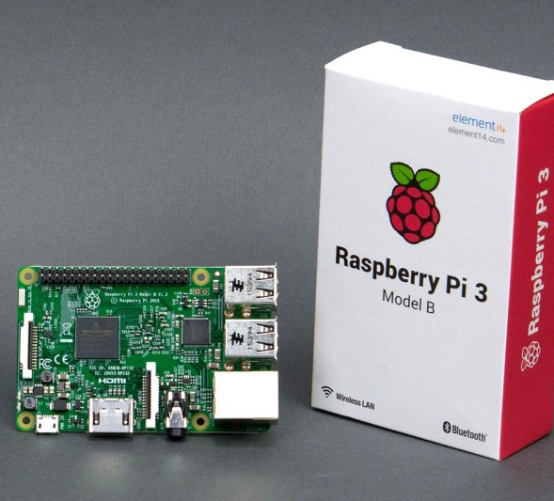
Raspberry Pi
Why Pi for IoT?
Cost
Accessibility
Community
Peripherals
First to market
Small, light, and “good enough”
Notes:
Cheap, easy, “real computer” means it is more accessible
Not good for real-time situations and definitely not good at catching things with absolute timings

Slide 9
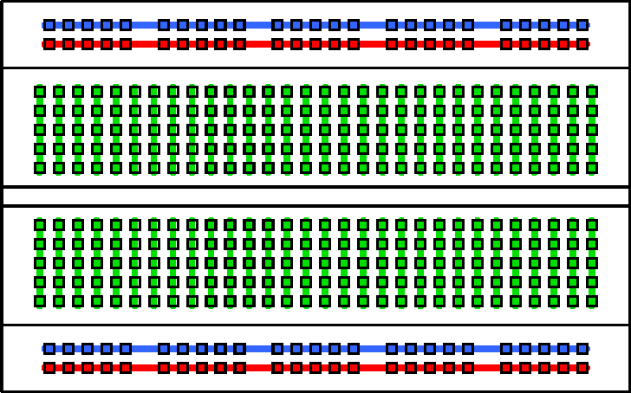
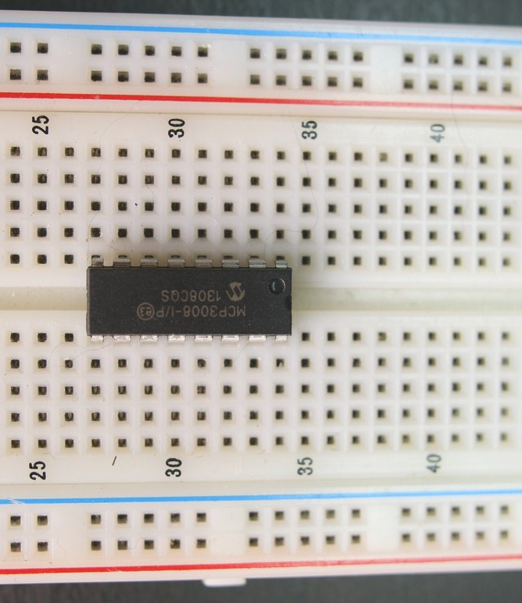
Breadboard basics
IC Chip
Terminal Strips
Columns (#’s)
IC Chip “Ravine”
Rows (Letters)

Slide 10
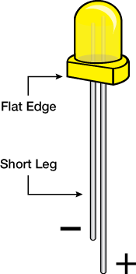
Resistors and LEDs
Notes:
Resistors reduce flow by introducing resistance to the electrical current
Graded in value of that resistance (OHMS)
Governed by Ohms law
LED lights make light through magic – small leg is the Ground side

Slide 11
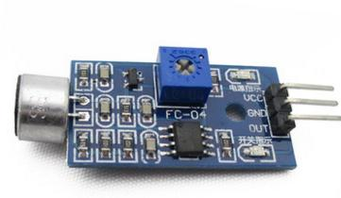
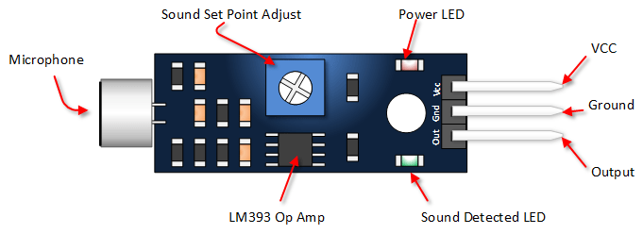
SENSOR Basics
Common Sensor pinout:
VCC = power IN
GND = power OUT (Ground)
Out(put) = signal out
Sometimes you get:
A0 = Analog output
D0 = Digital output

Slide 12
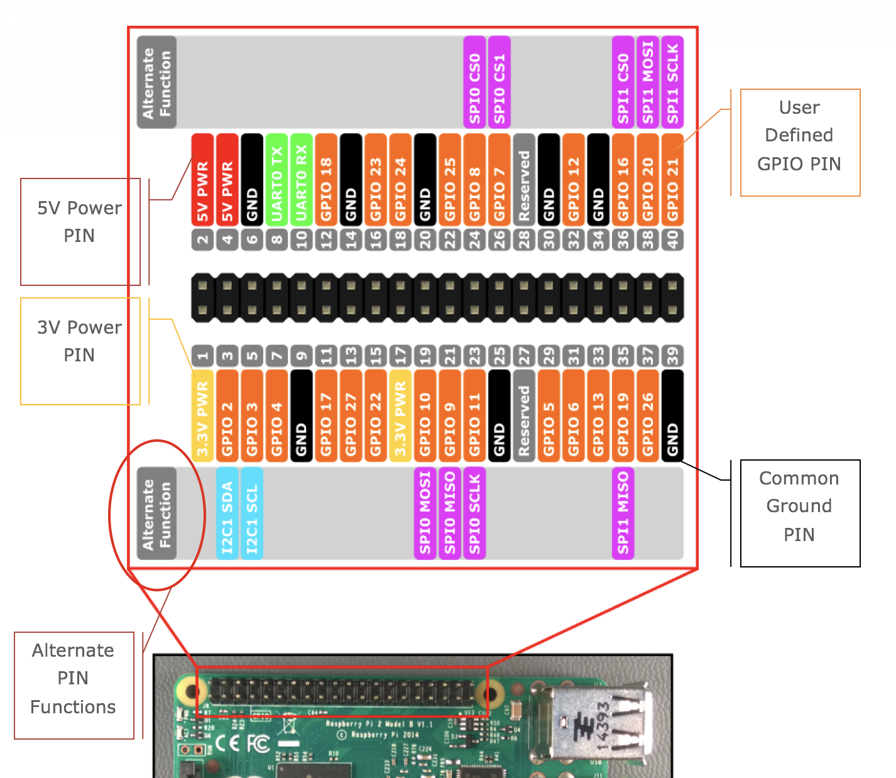
A pinout ‘splainer
Power
Ground
GPIO
Alternate Functions
Notes:
Page 7 in the companion

Slide 13
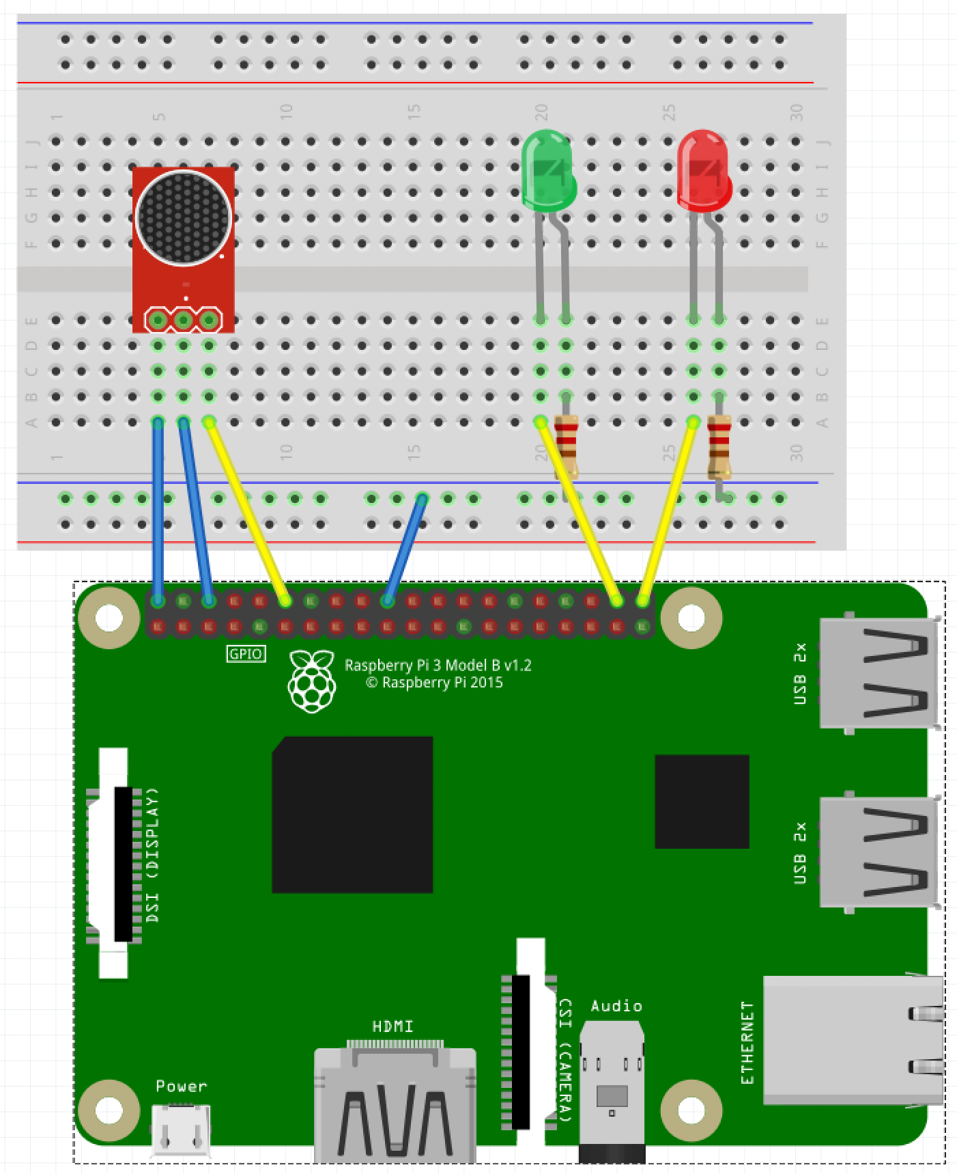
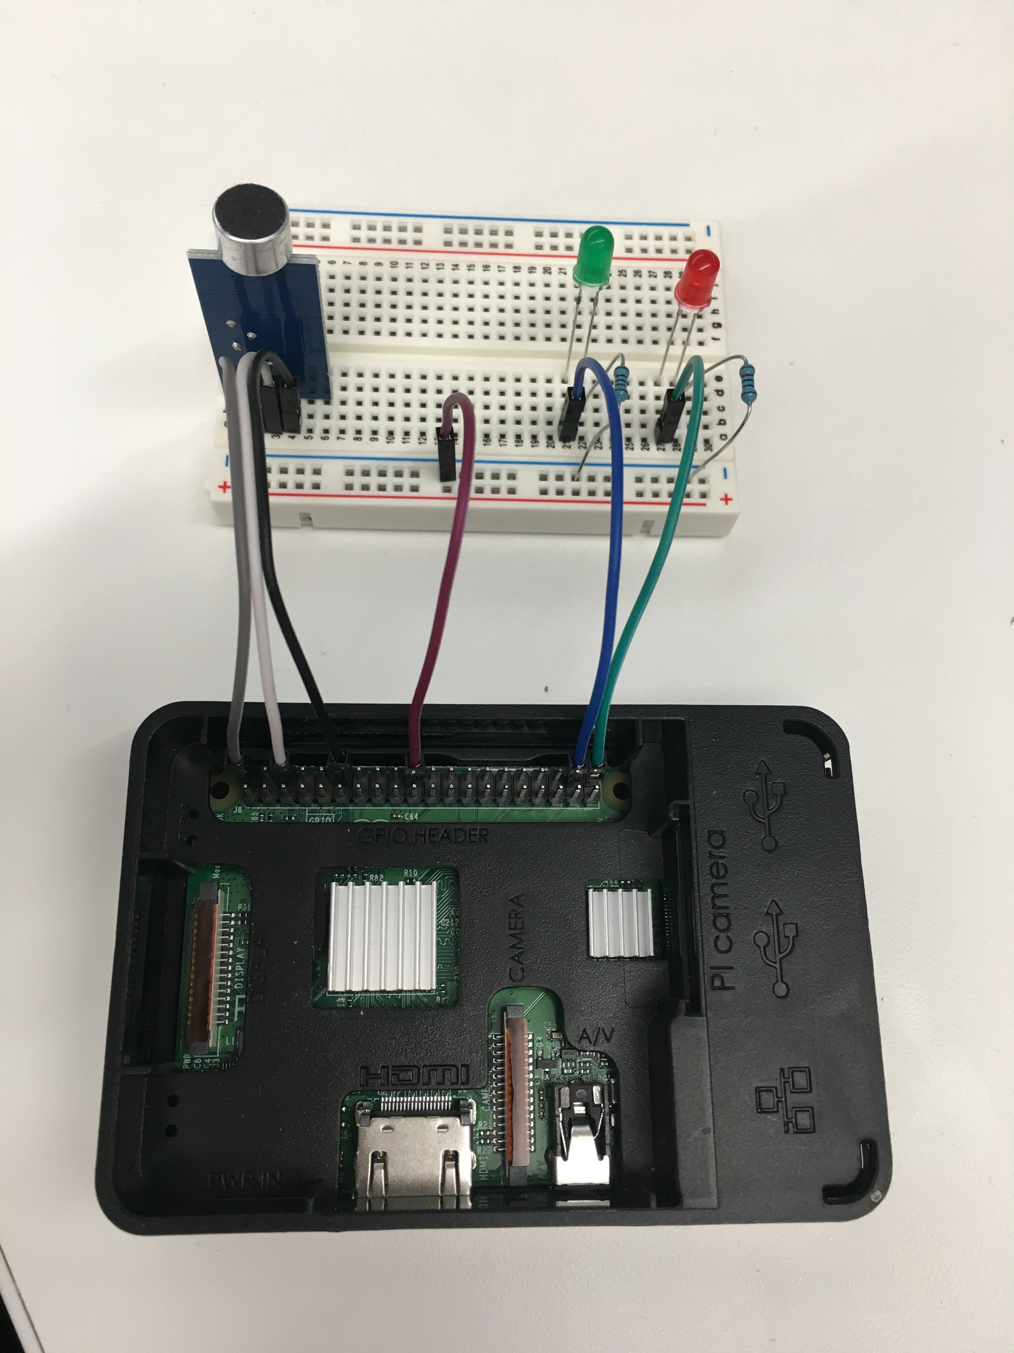
Slapping it all together
KISS – keep it simple, son!
Notes:
During the build, talk about things like:
Prototype vs commercial
Screwing around versus functional building
Long-term things you can do to get serious

Slide 14
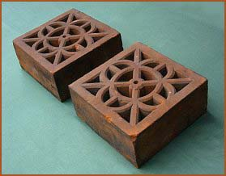
Now we have a Fancy Brick
It looks cool!
It matches the picture
It doesn’t do anything
Yet!

Slide 15
Take 15 minutes to RECOVER!

Slide 16
Take 15 more minutes to celebrate!

Slide 17
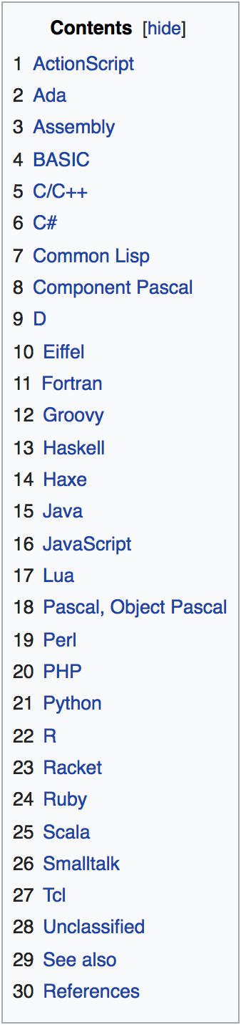

Code power!
How do we “build” software?
What are the resources you need?
Keeping track of code?

Slide 18
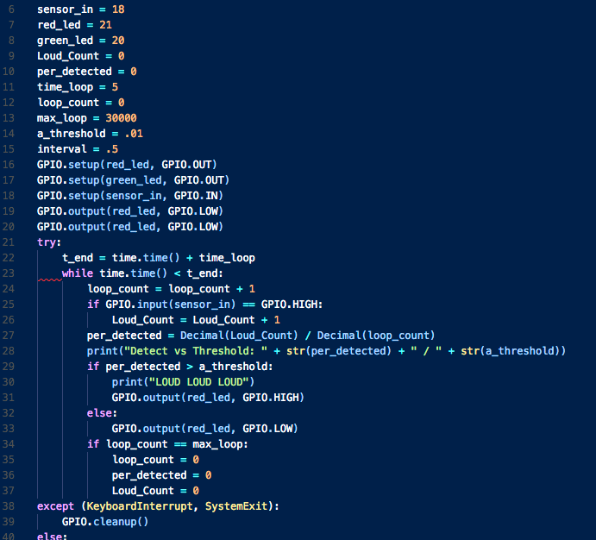
Software BASICS
Variables
Functions
Inputs
Outputs
Notes:
Languages and syntaxes and etc… all boil down to 4 things:

Slide 19
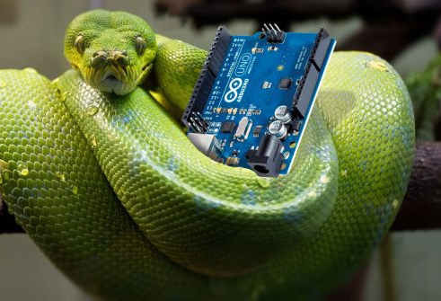

AS regards Python
Compact
Terse
Dynamically Typed
Control Characters
Structure (Indentation)
Notes:
Compact – do a LOT with a few lines of code
Terse – simple syntax and structure so less to type (good for lazy devs like me!)
Dynamically Typed – this means stuff changes during the code execution – this can be bad when you are learning, but will be so much easier later
Control Characters – there are very few unlike Java for example
Structure – STRICT on indenting and spaces/tabs and the use of them!!

Slide 20
Getting started with writing code
A development tool
A place to save code
Access to other libraries and info

Slide 21
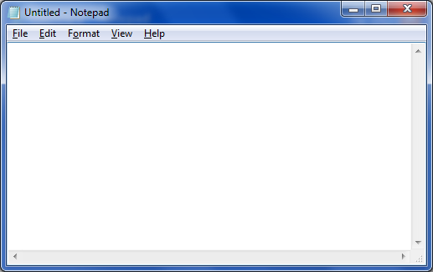
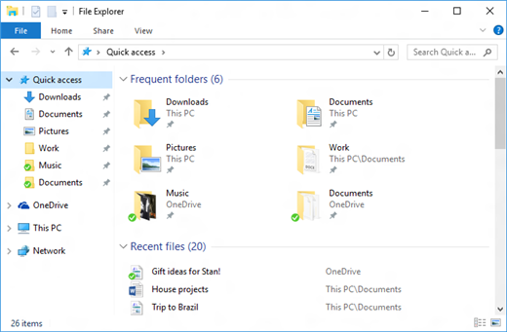
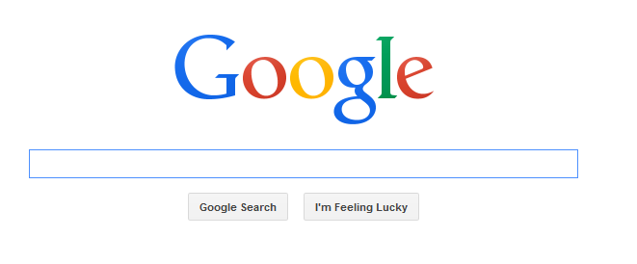








A TOOL
A PLACE TO PUT IT
RESOURCES

Slide 22
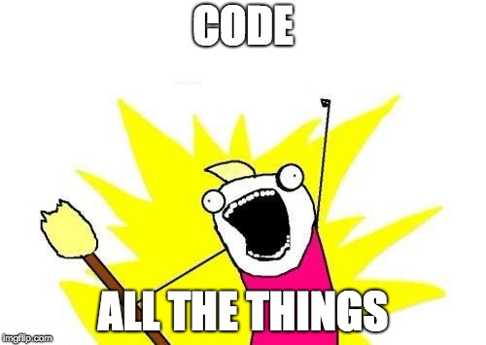
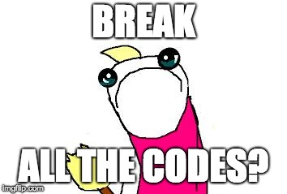
IT’s Coding time!

Slide 23
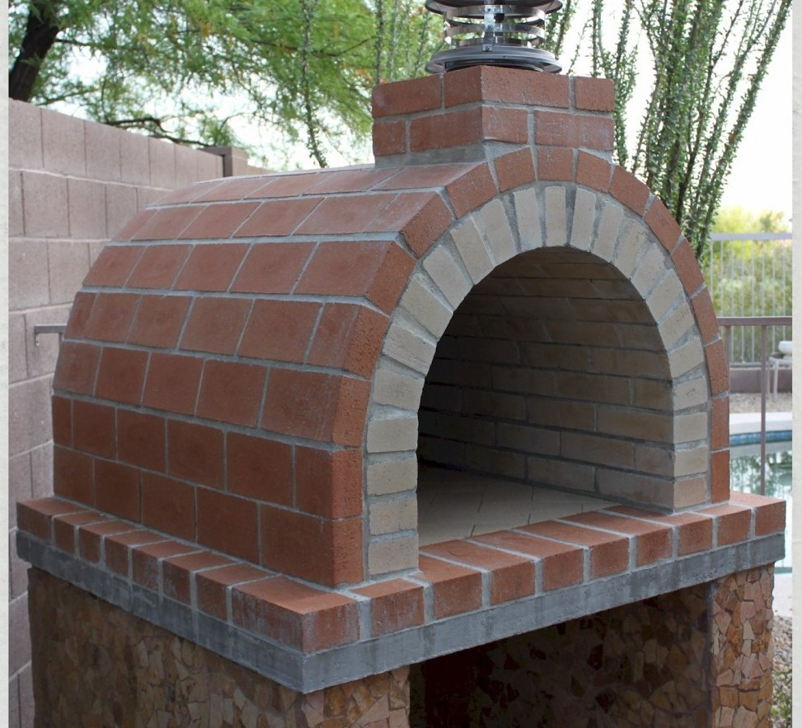
You have now made a brick oven!
It serves a functional purpose
It doesn’t just sit there
It works like you coded it to!

Slide 24
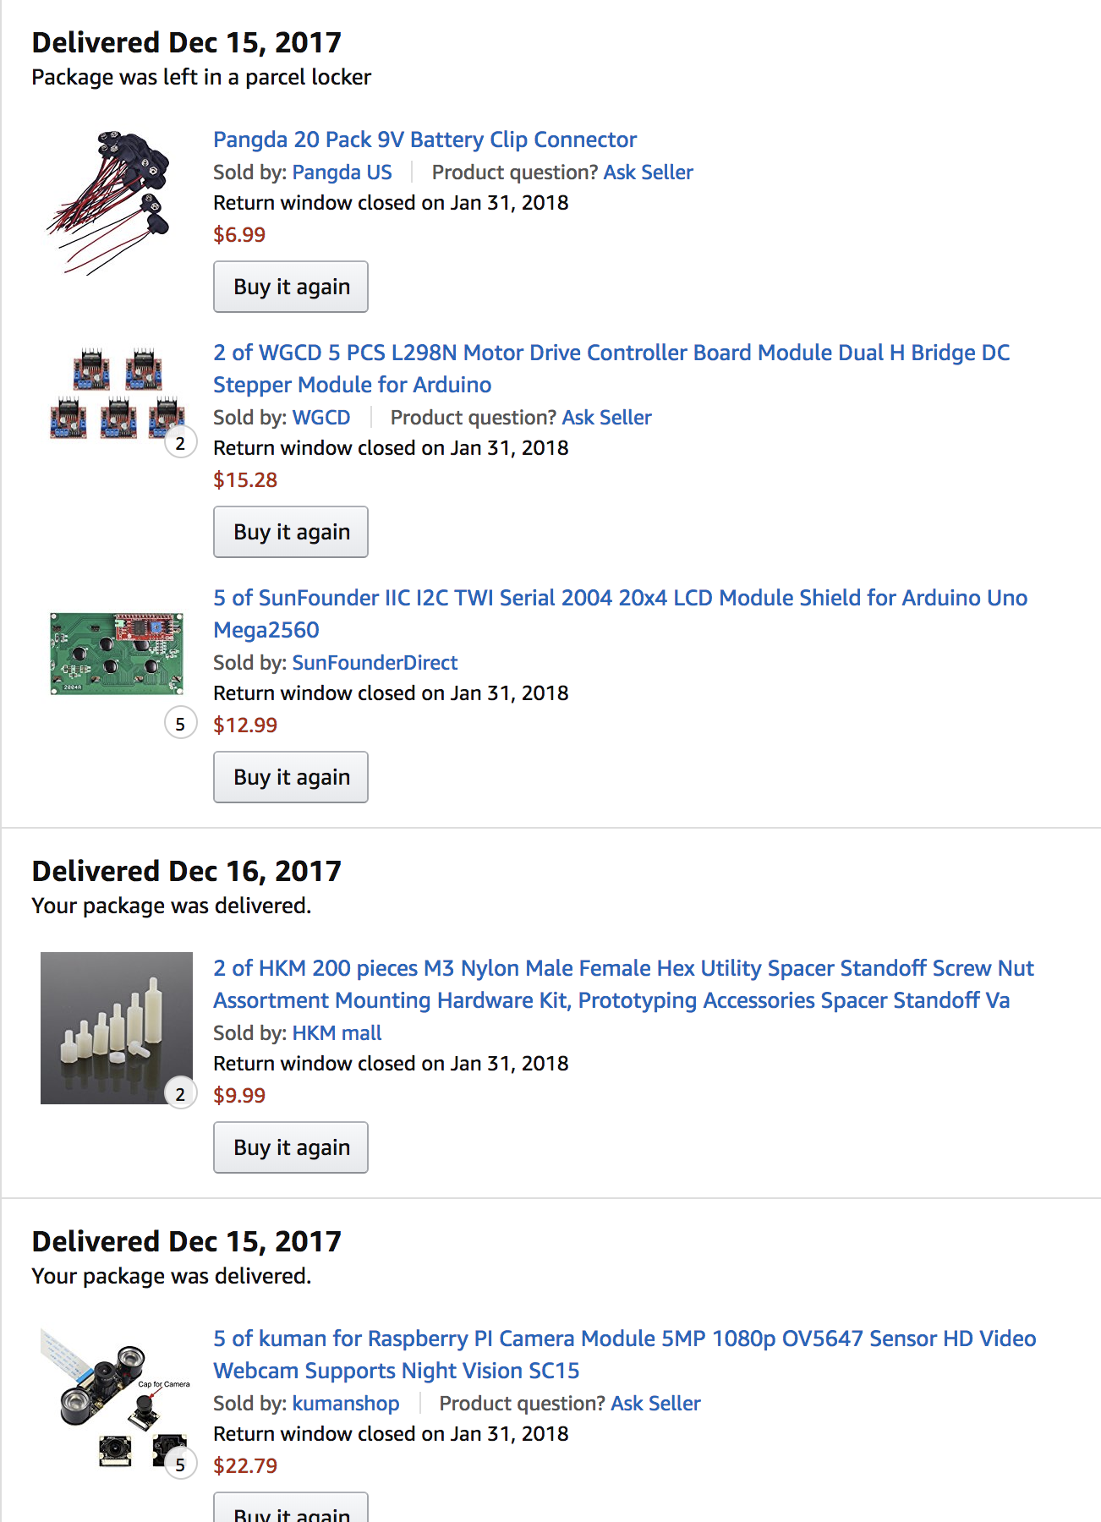
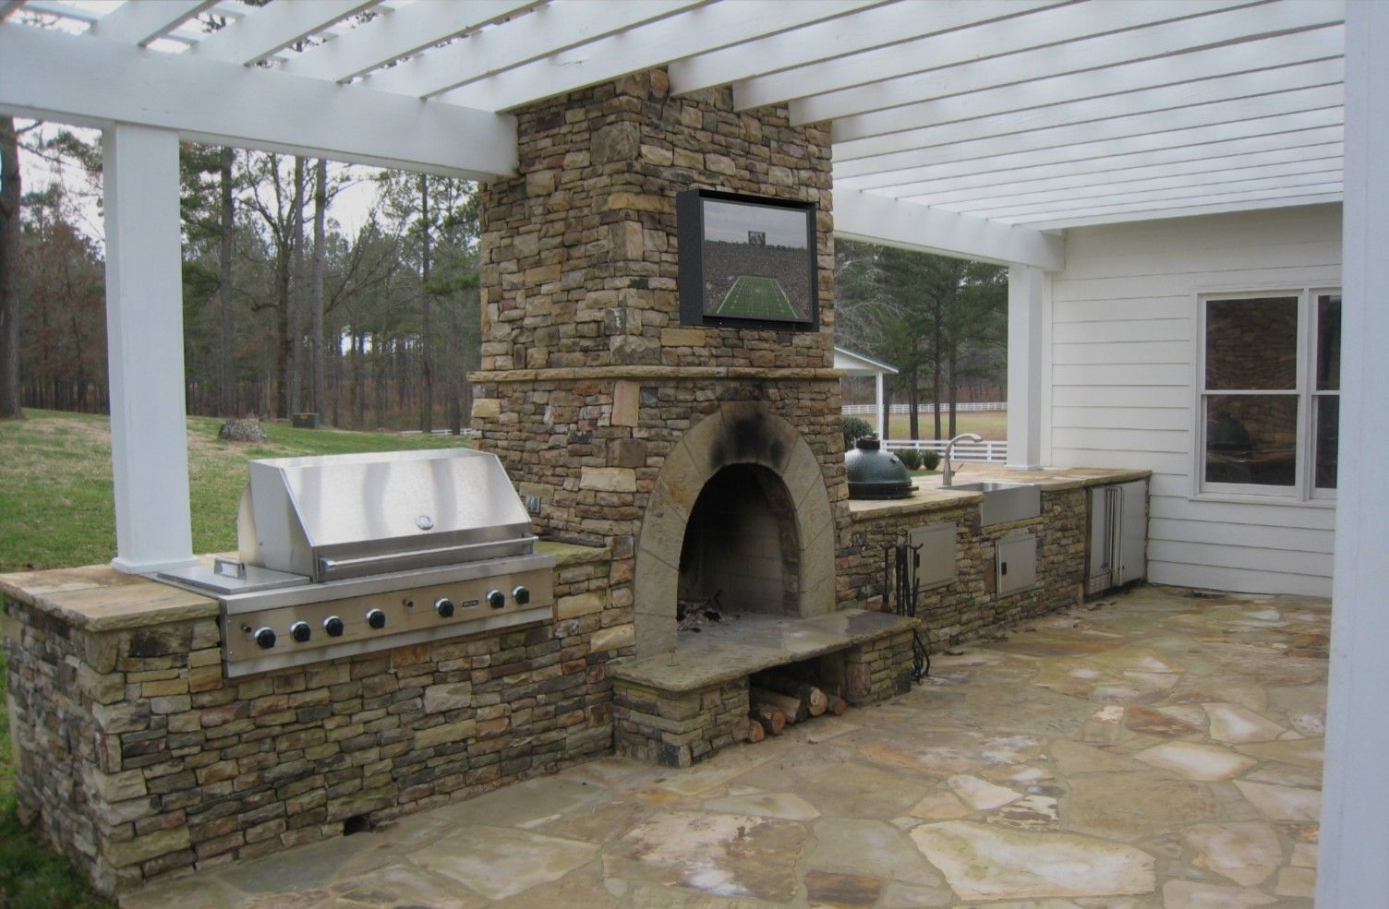
What’s next?
You have just taken the ”gateway drug” of making
Now your little oven will start to trigger new ideas and things you want to add
Soon you will have a fancy brick oven!
And your amazon order history will look like this:

Slide 25

Congratulations!
You’re officially an IoT Developer! Don’t forget to come get your Sticker!!

Slide 26
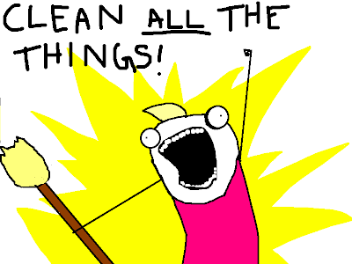
While we do Q and a
Disassemble your circuits
Put the parts in the baggie
Put everything back in the box

Slide 27
Some resources for you And a Favor for me
Official Resources:
Raspberypi.org
Python.org
Other Resources:
Youtube! Instructables! Amazon!
Github.com/ChrisHarrold
@charrold303 @codecoffeeyvr
A Favor:
http://bit.ly/charrold

